Slide 1
Procedural Modeling Project
Jaime Manuel Trillos Ujueta
Bonn University – March 2018

Slide 2
Motivation
The goal of this project is to use the different concepts and methods that we learned during the semester focused on Computer Graphics.
Procedural modeling is a term which use the creation of data algorithmically (random) for 3D models and textures from sets of rules.
The advantage of using procedural modeling is that helps developing complex scenes in less time and memory.

Slide 3
Modeling
Define a procedural grammar suitable for describing a room (including windows, doors, ...).
Parse a grammar file of such a procedural description.
Define the data structure for grammar and geometry (tree structure).
Apply procedural rules, generate room geometry and store it into the data structure.
Pass the intermediate result to renderer.

Slide 4
Procedural Grammar for Describing a Room
Definition of a rule:
Head=Rules operators:Probability
Example:
main=S(20,20,20) Subdiv(0,20){house}
wall1=Subdiv(1,5,10,5){wallpaper,wallMiddle1,wallpaper}:0.6
wall1=Subdiv(1,20){wallpaper}:0.4
The file can have comments using at the beginning #

Slide 5
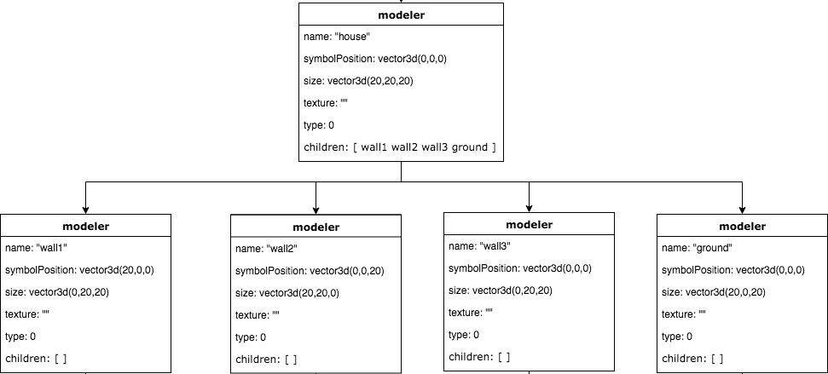
Procedural Grammar for Describing a Room
Comp(type){parameters} : Split scope into planes
The children obtain the position and the size from the father. It change depending of the side. {right, back, left, down, up, front}
Example:
house=Comp(sides){wall1,wall2,wall3,ground}
Taken:
P. Muller, G. Zeng, P. Wonka, and L. Van Gool. Image-based ¨ procedural modeling of facades. In SIGGRAPH, 2007

Slide 6
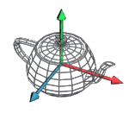
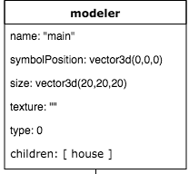
Procedural Grammar for Describing a Room
S(X,Y,Z) : Set new size
Example:
main=S(20,20,20) Subdiv(0,20){house}
Taken:
P. Muller, G. Zeng, P. Wonka, and L. Van Gool. Image-based ¨ procedural modeling of facades. In SIGGRAPH, 2007

Slide 7
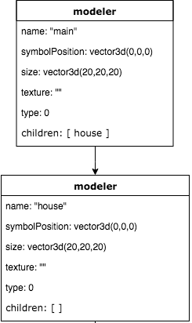
Procedural Grammar for Describing a Room
Subdiv(axis,arguments){parameters} : Divide scope in smaller scopes (children)
The children obtain the position and the size from
the father
Example:
main=S(20,20,20) Subdiv(0,20){house}
Axis are X=0, Y=1, Z=2
Taken:
P. Muller, G. Zeng, P. Wonka, and L. Van Gool. Image-based ¨ procedural modeling of facades. In SIGGRAPH, 2007

Slide 8

Procedural Grammar for Describing a Room
S3d(axis,size) : Set new size for an specific axis
Example:
chair1=S3d(1,6) I(cube){rug}:0.4
Axis are X=0, Y=1, Z=2

Slide 9
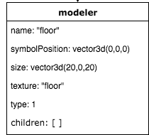

Procedural Grammar for Describing a Room
I(typeObject){texture} : Instance of a geometry and texture
Example:
floor=I(plane){floor}
Texture
Type 1 = PLANE
Taken:
P. Muller, G. Zeng, P. Wonka, and L. Van Gool. Image-based ¨ procedural modeling of facades. In SIGGRAPH, 2007

Slide 10
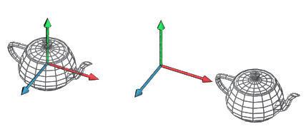


Procedural Grammar for Describing a Room
Example:
chair1=S3d(1,4) T(4,0,0) R(90,0,0) I(chair){armchair}:0.6
T(X,Y,Z) : Translation of an object
Taken:
P. Muller, G. Zeng, P. Wonka, and L. Van Gool. Image-based ¨ procedural modeling of facades. In SIGGRAPH, 2007

Slide 11
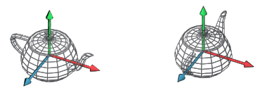
Procedural Grammar for Describing a Room
R(angleX,angley,angleZ) : Rotating around axis
Example:
chair1=S3d(1,4) T(4,0,0) R(90,0,0) I(chair){armchair}:0.6
Taken:
P. Muller, G. Zeng, P. Wonka, and L. Van Gool. Image-based ¨ procedural modeling of facades. In SIGGRAPH, 2007

Slide 12
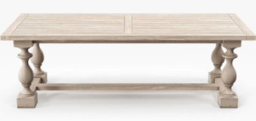
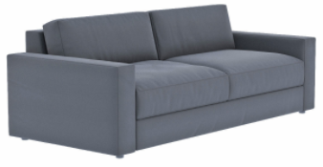

Procedural Grammar for Describing a Room
In order to describe the primitive geometry and furniture objects, I create a global variable (typeObjects):
enum TypeObject { SCOPE, PLANE, CUBE, CYLINDER, SOFA, TABLE, CABINET, CHAIR, TOY };

Slide 13
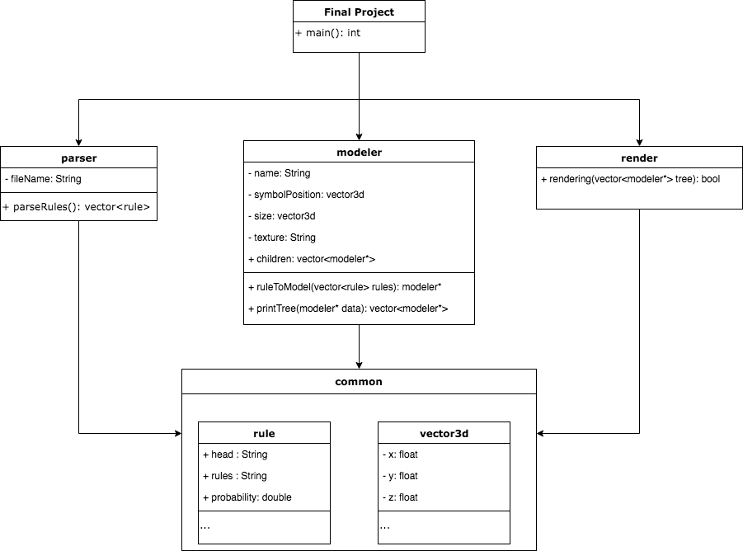
Oriented Object Model

Slide 14
Parsing the File
Read the file and save it in a vector<string>.
Parse the vector<string> into a vector<rule>.
Save the repeat heads in a temporal vector<rule>.
Create a random between 0 and 1.
Find the nearest probability with the random; save the winner in another vector<rule>.
Erase the losers from the original vector<rule>.
And repeat it until there is no more repeat heads.
Return the vector<rule>

Slide 15
Modeler: Data Structure (Tree)
Transform the vector<rule> into a map<string,string>
Initialize the model (modeler* tree) and add the model in vector<modeler*> list (global variable)
Copy the first model in the list in a temporal variable (modeler* currentModel) and extract the head in another variable (string modelerName)
Erase the first element of the list
Search in the map if the head exist with respect to modelerName
Extract the rules and parse until have each operator rule (vector<string> keys)
Compare if the keys start with (T,S,S3d,Subdiv,Comp,I,…)
Transform the rules in model. If it contain children e.g Subdiv then save it in the model but also adding it to the vector<modeler*> list
Do the process until there is no more models in the list
Return the tree

Slide 16
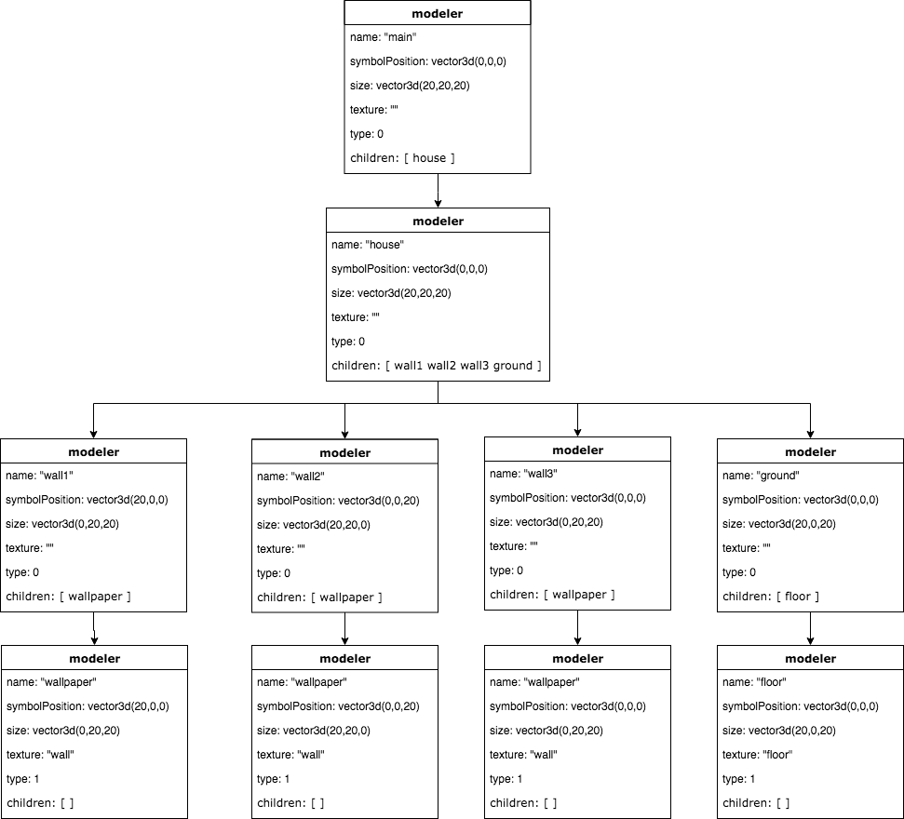
Tree Structure
Type 0 = SCOPE
Type 1 = PLANE
main=S(20,20,20) Subdiv(0,20){house}
house=Comp(sides){wall1,wall2,wall3,ground}
wall1=Subdiv(1,20){wallpaper}
wall2=Subdiv(1,20){wallpaper}
wall3=Subdiv(1,20){wallpaper}
ground=Subdiv(0,20){floor}
wallpaper=I(plane){wall}
floor=I(plane){floor}

Slide 17
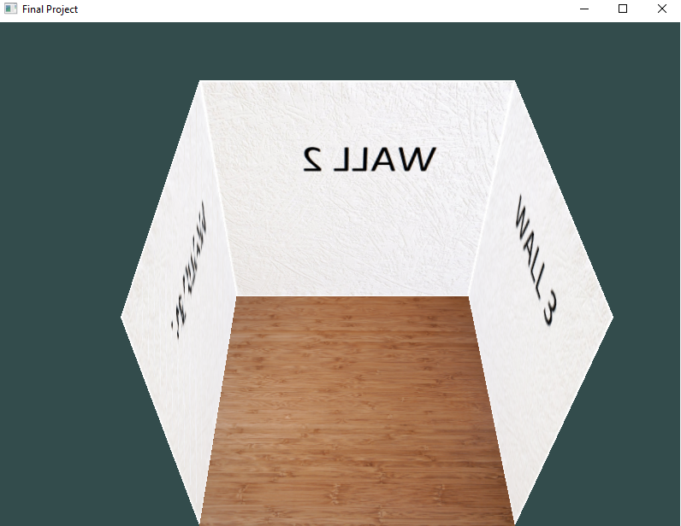
Tree Structure
Type 0 = SCOPE
Type 1 = PLANE

Slide 18
Result to Rendering
Transform the modeler* tree in a vector<modeler*> model
Save the model in a global variable
Call the function drawTree(Shader ourShader)
Save the respective model in the ourShader variable and render it.
The program permits zoom, movement in the scene with the WASD/arrow keys and mouse.

Slide 19
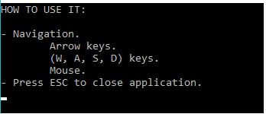
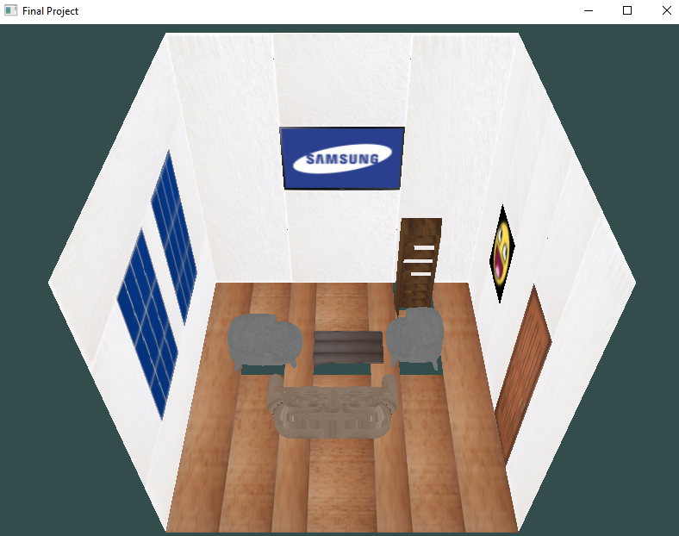
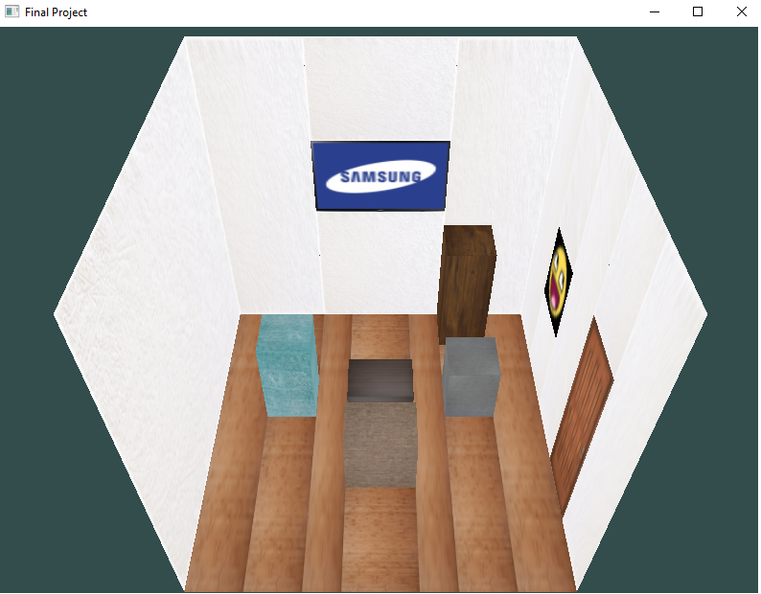
Screenshots
RuleObjects.txt
Rule.txt
RuleTest.txt

Slide 20
Thank you. Questions?

